Slide 1


SYSTEMS OF LINEAR EQUATIONS AND MATRICES
Solving Systems of Linear Equations
SIMULTANEOUS EQUATION

Slide 2
SIMULTANEOUS EQUATION
Simultaneous linear equation in two unknowns
Solved using: (a) elimination
(b) substitution
Example 1:
Solve the following equations:
x - y = 5
2x + y = 1

Slide 3
SIMULTANEOUS EQUATION
Solution using elimination method:
x – y = 5 ---------- (1)
2x + y = 1----------(2)
Take: (1)X2,
Get: 2x-2y=10 -------(3)
(2)-(3),
2x+y=1
(-) 2x-2y=10
3y = -9
y = -3
Find the same coefficient
of x or y
If it is not the same, you
can multiply the equation to
get same coefficient
To eliminate, use ‘+’ or ‘-’
After elimination, you will find
the value of 1 unknown
4) Substitute in the value to find
the value of second unknown

Slide 4
SIMULTANEOUS EQUATION
Replace/substitute y=-3 into (1):
x - y = 5
x - (-3) = 5
x = 2

Slide 5
SIMULTANEOUS EQUATION
Example 2:
Solve 3x - 5y -7 = 4x + 3 = 2x + y + 16
Solution:
Form two equations:
3x-5y-7=4x+3
-x-5y=10------(1)
4x+3=2x+y+16
2x-y=13------(2)

Slide 6
SIMULTANEOUS EQUATION
Solution:
-x-5y=10------(1)
2x-y=13------(2)
Take (1)X2: -2x-10y=20 ------(3)
(3)+(2):
-2x-10y=20 ------(3)
(+) 2x-y=13 ---------(2)
-11y =33
y=-3
Substitute y=-3 into (1):
-x-5(-3)=10
-x=10-15
x = 5

Slide 7
SIMULTANEOUS EQUATION
Simultaneous linear equation in three unknowns
- Three unknowns which involve x, y and z
Solved using: (a) elimination
(b) substitution
- First, combine three equations become 2 equations with two unknowns

Slide 8
SIMULTANEOUS EQUATION
Example: Solve x-2y+3z=11, 4x+2y-3z=4, 3x+3y-z=4
Solution using elimination method:
x-2y+3z=11 ---------- (1)
4x+2y-3z=4 ----------(2)
3x+3y-z=4 -----------(3)
Take (1)X4: 4x-8y+12z=44--------(4)
(2)-(4):
Get: 10y-15z=-40--------(5)
Take (1)X3: 3x-6y+9z=-33--------(6)
(3)-(4):
Get: 9y-10z=-29---------(7)

Slide 9
SIMULTANEOUS EQUATION
We have : 10y-15z=-40-------(5)
9y-10z=-29--------(7)
Again using the elimination method to solve the
simultaneous equation of two unknowns, we will
Get z=2 and y=-1
Then, replace y=-1 and z=2 into (1);
X-2(-1)+3(2)=11
X=11-2-6
=3

Slide 10
Type of solution:
Case where we can find the answer of x and y (for 2X2 system) and x, y and z (for 3X3 system)
The intersection point
is the answer for
x and y

Slide 11
Type of solution:
No solution (parallel lines)
(happen for the case 0x + 0y = k,
where k is a constant)

Slide 12
Type of solution:
Infinite solution (same lines)
- happen for the case 0x+0y = 0

Slide 13
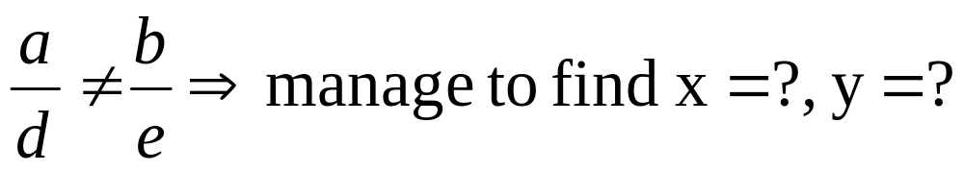
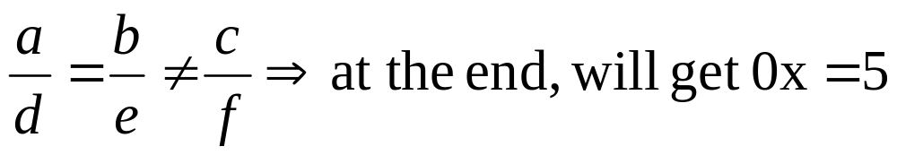
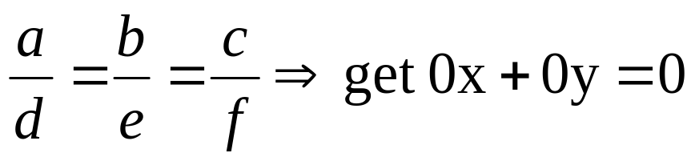
Type of solution
For system 2 X 2,
ax + by = c
dx + ey = f
Unique solution:
No solution:
Infinite solution:

Slide 14
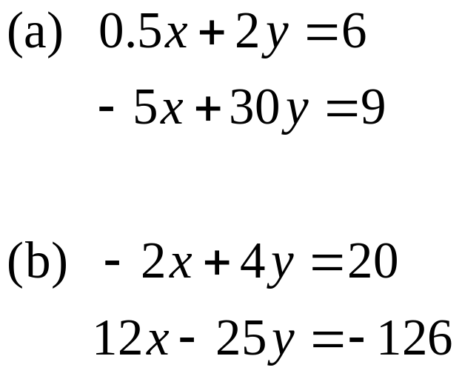
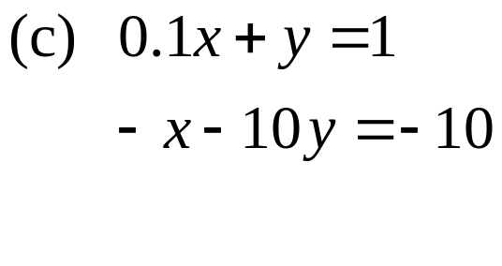
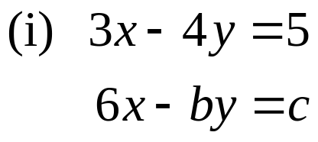
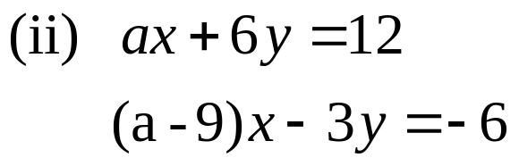
Example
Solve
Find the values of the constants for which there is
(a) No solution (b) infinite solution

Slide 15
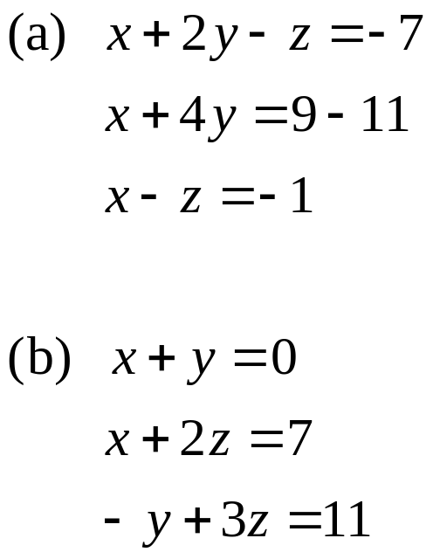
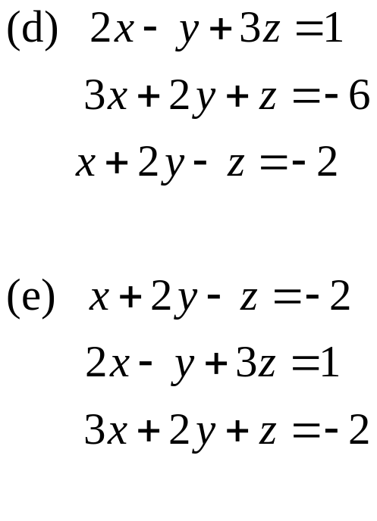
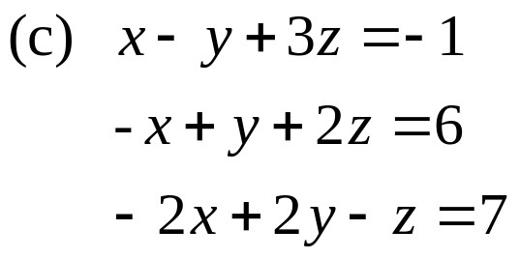
Example
Solve

